Slide 1

Project Tracking System
Group 7
Master -101820308蔡易儒
DEV – 101820302施帛辰
DEV – 101820329林家文
DEV – 101820331陳亮宇
DEV – 101820340鄒令業
指導教授：劉建宏 教授

Slide 2
History of The Project
Iteration | Hours | Date | Significant Change
Iteration 1.1 | 55 | 2015/10/14 ~ 2015/10/25 | Login/Register System
Iteration 1.2 | 26.5 | 2015/10/26 ~ 2015/11/02 | Project Manage System 規劃 & 實作
Iteration 1.3 | 16.5 | 2015/11/03 ~ 2015/11/09 | Project Manage System 實作
Iteration 1.4 | 20 | 2015/11/10 ~ 2015/11/16 | Requirement Manage System 規劃 & 實作
Iteration 1.5 | 16 | 2015/11/17 ~ 2015/11/23 | Requirement Manage System 實作
Iteration 1.6 | 22.5 | 2015/11/24 ~ 2015/11/30 | Requirement Manage System 實作
Iteration 1.7 | 18.5 | 2015/12/01 ~ 2015/12/07 | Test Case View 規劃 & 實作 Add GUI Tests
Iteration 1.8 | 20 | 2015/12/08 ~ 2015/12/14 | Test Case View 實作 Bug fixed
Iteration 1.9 | 28.5 | 2015/12/15 ~ 2015/12/21 | Report View 規劃 & 實作 Bug fixed
Iteration 1.10 | 21.5 | 2015/12/22 ~ 2015/12/28 | Report View 實作
Iteration 1.11 | 21 | 2015/12/29 ~ 2015/01/04 | Bug fixed

Slide 3
Personal Evaluation to Project Contributions

Slide 4
Personal Evaluation to Project Contributions

Slide 5
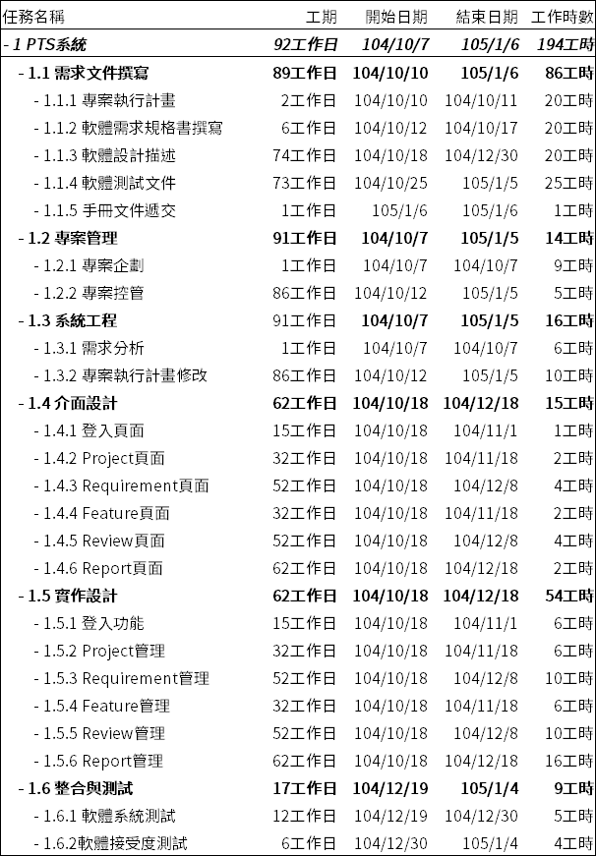
Personal Evaluation to Project Contributions
成員 | 工作分配 | 實際工時
蔡易儒 | 組長 - 統籌會議、管理專案進度 API開發 & 前端頁面 | 46.5
陳亮宇 | API開發 & 前端頁面 MAINTAINENCE | 51
鄒令業 | API開發 & GUI美術設計 開發執行測試專案 | 43
林家文 | API開發& 前端頁面 開發執行測試專案 | 34
施帛辰 | API開發& 前端頁面 文件撰寫&管理 | 47
預估工時合計(小時) |  | 194
實際工時合計(小時) |  | 221.5 (+26.5)

Slide 6
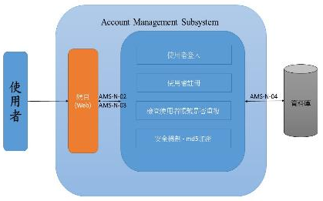
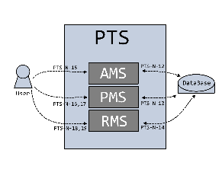
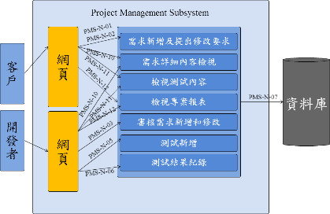
Analysis and Design Models

Slide 7
Overall Project Deliverables
 | Requirement Content | Check
R1 | Provide a project management mechanism. | V
R2 | Provide a requirement collection mechanism for a given project. | V
R3 | Provide a mechanism for editing/managing test cases for corresponding requirements. | V
R4 | Maintain the dependent relationships between the requirements and test cases. | V
R5 | Provide a requirement review/approval mechanism for a given project. | V
R6 | Able to generate corresponding reports and traceability matrix. | V
R7 | Able to support management of requirement hierarchy. | V
R8 | Provide a user friendly interface (UI). | V

Slide 8
Project Retrospective
What We Learned?
How to manage a project in AGILE development
How to estimate the time of each task more precisely
Scrum流程改善
Planning 需要更詳細
工作分工方式
BUGs的處理方式需要更加完善
每位工程師的專長不一
GitHub
https://github.com/LutherTsaiTW/2015SoftwareEngineering

Slide 9
DEMO CLICK
Account: teacher1234
Password: Teacher1234

